Slide 1
Introduction to transport
protocol functionality
1
A list of well-known transport layer ports
http://www.iana.org/assignments/service-names-port-numbers/service-names-port-numbers.xml
Notes:
http://highered.mheducation.com/sites/0072515848/student_view0/chapter22/index.html
We’d also be seeing two common TCP/ IP end-to-end transport protocols that provide contrasting services: the first (UDP) provides a simple demultiplexing service and the other (TCP) provides a reliable byte stream service.

Slide 2


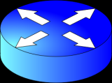
Process-to-Process Comm.
Recap
HTTP Request
Browser
Communicating
App Processes
SEECS Webserver
202.125.157.150:2123
115.186.131.71:80
HTTP Reply

Slide 3
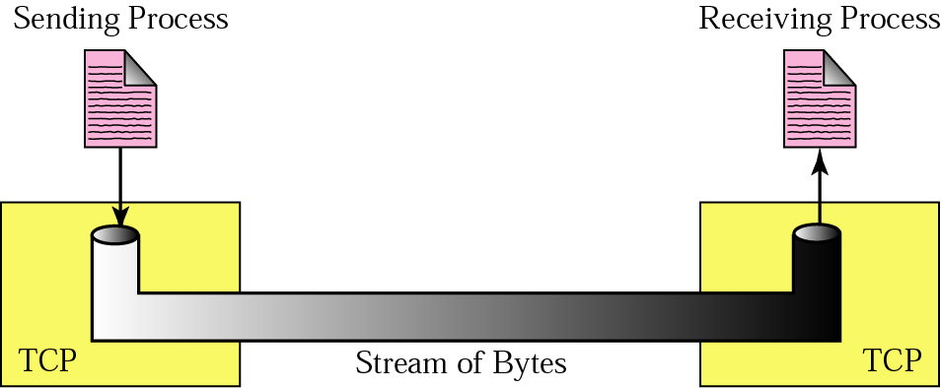
1
TCP Protocol Basics
Segment format; Flow Control
A port number is a way to identify a specific process to which an Internet or other network message is to be forwarded when it arrives at a server. For the Transmission Control Protocol and the User Datagram Protocol, a port number is a 16-bit integer that is put in the header appended to a message unit.

Slide 4
How Encapsulation Works?
Recap
Imagine you’d like to open a website (let’s say www.seecs.edu.pk)
Application data
GET / HTML/1.1
Source Port | Destination Port
> 1024 | 80
Payload
TCP Segment
Payload
IP Packet
Source IP | Destination IP
202.125.157.150 | 79.140.80.57
Payload
Payload
MAC Frame
Source MAC address | Destination MAC address 23:34:aa:bb:cc:dd | 12:34:aa:bb:cc:dd
Payload
FCS
a port is an endpoint to a logical connection and the way a client program specifies a specific server program on a computer in a network
Notes:
We now revisit one of the examples we’ve seen in our class previously.
a port is an endpoint to a logical connection and the way a client program specifies a specific server program on a computer in a network

Slide 5
Recall that IP is best-effort; i.e., packets can be:
Lost, delayed, duplicated, delivered out of order, corrupted.
Transport-layer functionality
Support for multiple application processes on hosts
Guaranteed message delivery
Sequenced and ordered message delivery
Non duplicate message delivery
Support for arbitrarily large messages
Support for sender/ receiver synchronization
Support for receiver applying flow-control to sender
Q: What is flow control?
Notes:
Two forces shape the end-to-end protocol. From above, the application-level processes that use its services have certain requirements. The following list itemizes some of the common properties that a transport protocol can be expected to provide:
■ guarantees message delivery
■ delivers messages in the same order they are sent
■ delivers at most one copy of each message
■ supports arbitrarily large messages
■ supports synchronization between the sender and the receiver
■ allows the receiver to apply flow control to the sender
■ supports multiple application processes on each host
Note that this list does not include all the functionality that application processes might want from the network. For example, it does not include security, which is typically provided by protocols that sit above the transport level.
The underlying best-effort network has on the other hand certain limitations in the level of service it can provide. Some of the more typical limitations of the network are that it may
■ drop messages
■ reorder messages
■ deliver duplicate copies of a given message
■ limit messages to some finite size
■ deliver messages after an arbitrarily long delay
Therefore, the job of the transport layer protocol is to mask these imperfections of the underlying network.

Slide 6
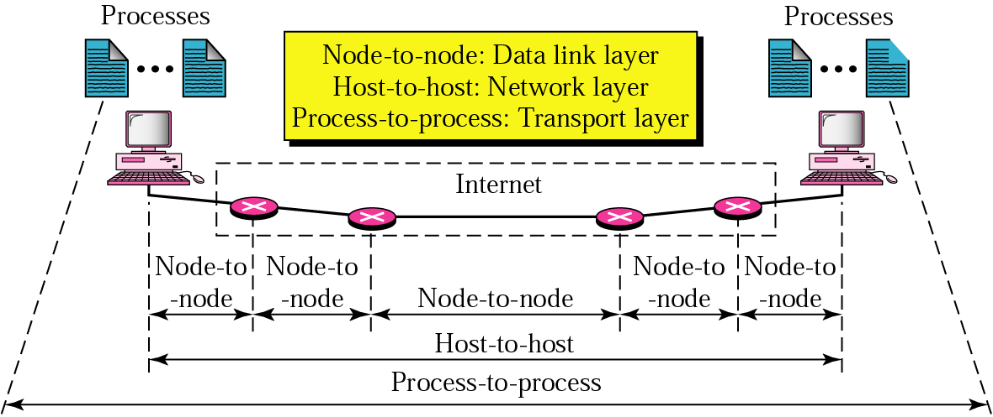
Various protocols at the Transport Layer
Provides logical communication between processes
1 – UDP – Connection less, unreliable
2 – TCP – Connection oriented, reliable
3 – SCTP – Features of both (RFC 4960)
Multiplexing and de-multiplexing is carried out at the transport layer in order to allow multiple processes to communicate.
Processes use sockets to communicate with the network layer.
Error checking also performed
at the transport layer (RFC 1071)
Q: How is the transport layer functionality
different from the network layer?

Slide 7
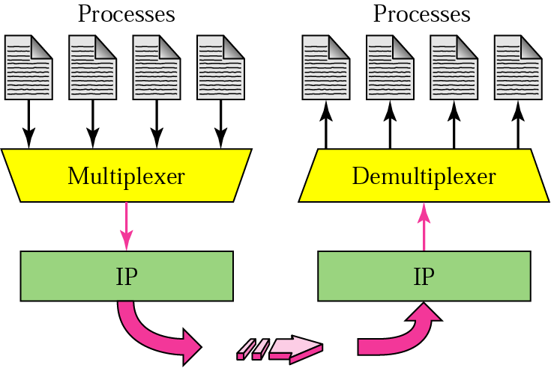
2
User Datagram Protocol: UDP
Some apps. that use UDP: DNS, RIP, SNMP, Streaming, VoIP
Finer application level control on when data is transmitted
No connection establishment
No connection state
Small header overhead
8 bytes compared to 20 bytes in TCP
UDP: Simple because it only adds port numbers and some error correction before sending to IP Layer.
(Minimum extra information is added.)
Notes:
Q: what happens in TCP?
No data is sent if there is congestion
TCP will re-transmit until successful delivery

Slide 8
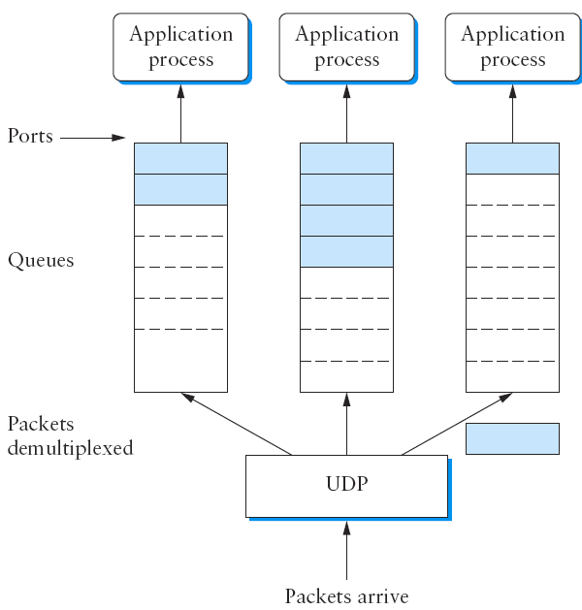
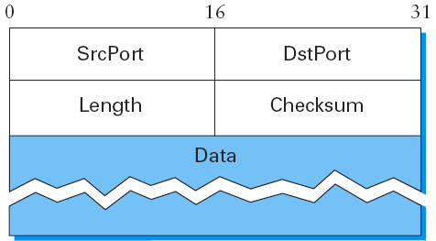
User Datagram Protocol
A transport layer packet is also called a “segment”.
UDP packets may be referred to as “datagrams”
Notes:
IPv4 protocol is 65,507 bytes (65,535 [8 byte UDP header + 20 byte IP header])
IPv6 jumbograms allow for more than 65,535 bytes
The only interesting issue in such a protocol is the form of the address used to identify the target process. Although it is possible for processes to directly identify each other with an OS-assigned process id (pid), such an approach is only practical in a closed distributed system in which a single OS runs on all hosts and assigns each process a unique id. A more common approach, and the one used by UDP, is for processes to indirectly identify each other using an abstract locator, often called a port
or mailbox.
The basic idea is for a source process to send a message to a port and for the destination process to receive the message from a port. The header for an end-to-end protocol that implements this demultiplexing function typically contains an identifier (port) for both the sender (source) and the receiver (destination) of the message. For example, the UDP header is given in the figure above on the RHS. Notice that the UDP port field is only 16 bits long. This means that there are up to 64K possible ports, clearly not enough to identify all the processes on all the hosts in the Internet. Fortunately, ports are not interpreted across the entire Internet, but only on a single host. That is, a process is really identified by a port on some particular host—a port, host pair. In fact, this pair constitutes the demultiplexing key for the UDP protocol.
The next issue is how a process learns the port for the process to which it wants to send a message. Typically, a client process initiates a message exchange with a server process. Once a client has contacted a server, the server knows the client’s port (it was contained in the message header) and can reply to it. The real problem, therefore, is how the client learns the server’s port in the first place. A common approach is for the server to accept messages at a well-known port. That is, each server receives its messages at some fixed port that is widely published, much like the emergency telephone service available at the well-known phone number 911. In the Internet, for example, the
Domain Name Server (DNS) receives messages at well-known port 53 on each host, the mail service listens for messages at port 25, and the Unix talk program accepts messages at well-known port 517, and so on. This mapping is published periodically in an RFC and is available on most Unix systems in file /etc/services. Sometimes a well-known port is just the starting point for communication: The client and server use the well-known port to agree on some other port that they will use for subsequent communication, leaving the well-known port free for other clients.
Finally, although UDP does not implement flow control or reliable/ordered delivery, it does a little more work than to simply demultiplex messages to some application process—it also ensures the correctness of the message by the use of a checksum. (The UDP checksum is optional in the current Internet, but it will become mandatory with IPv6.) UDP computes its checksum over the UDP header, the contents of the message body, and something called the pseudoheader. The pseudoheader consists of three fields from the IP header—protocol number, source IP address, and destination IP address—plus the UDP length field. (Yes, the UDP length field is included twice in the checksum calculation.) UDP uses the same checksum algorithm as IP

Slide 9
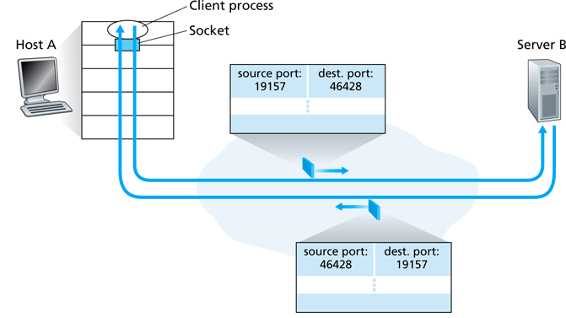
Transport layer ports
Source and destination ports represent applications generating the packet and towards which the packet is destined; therefore, depends on the direction of packet flow

Slide 10
What should be the maximum length of a UDP datagram?
8 byte header + 65,527 bytes of data
Notes:
The minimum length is 8 bytes because that is the length of the header. The field size sets a theoretical limit of 65,535 bytes (8 byte header + 65,527 bytes of data) for a UDP datagram. However the actual limit for the data length, which is imposed by the underlying IPv4 protocol, is 65,507 bytes (65,535 − 8 byte UDP header − 20 byte IP header

Slide 11
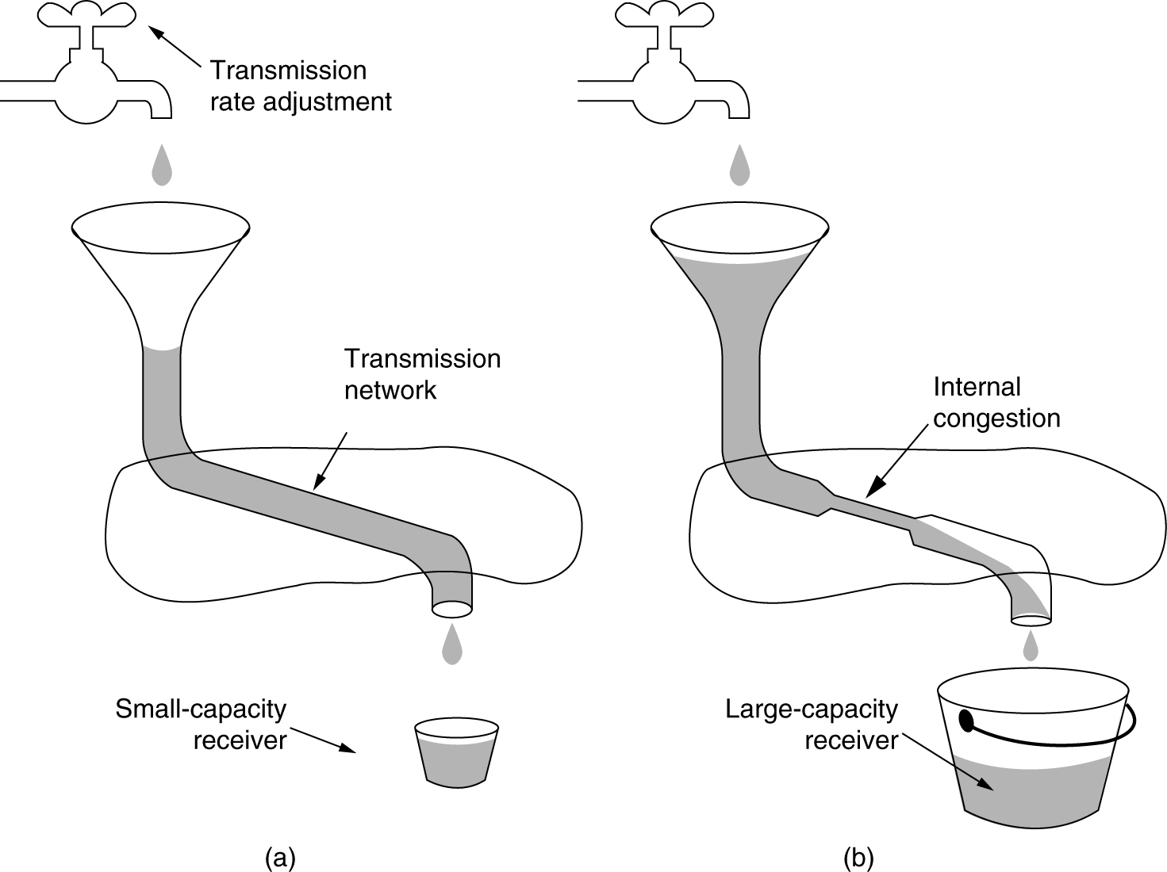
Flow vs Congestion Control
Flow Control
Congestion Control
Notes:
Credit: Forouzan

Slide 12
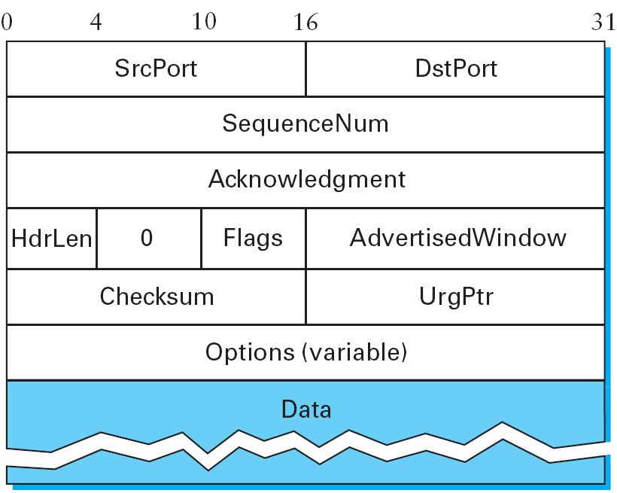
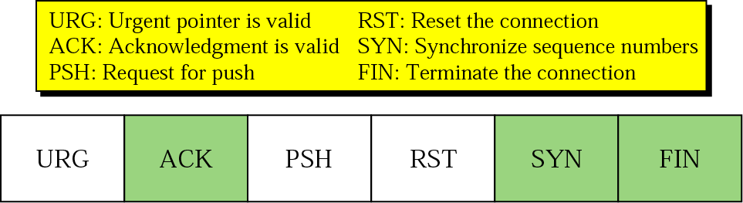
TCP Segment Format
Notes:
The Acknowledgment, SequenceNum, and AdvertisedWindow fields are all involved in TCP’s sliding window algorithm. Because TCP is a byte-oriented protocol, each byte of data has a sequence number; the SequenceNum field contains the sequence number for the first byte of data carried in that segment. The Acknowledgment and AdvertisedWindow fields carry information about the flow of data going in the other direction.
The 6-bit Flags field is used to relay control information between TCP peers. The possible flags include SYN, FIN, RESET, PUSH, URG, and ACK. The SYN and FIN flags are used when establishing and terminating a TCP connection, respectively. The ACK flag is set any time the Acknowledgment field is valid, implying that the receiver should pay attention to it. The URG flag signifies that this segment contains urgent data. When this flag is set, the UrgPtr field indicates where the nonurgent data contained in this segment begins. The urgent data is contained at the front of the segment body, up to and including a value of UrgPtr bytes into the segment.

Slide 13
Sequence Number
Maintained for each TCP session
Increases reliability of service along with ACK
SYN Flag signifies start of a TCP session therefore sequence number starts at SYN
During a communication, sequence number keeps track of bytes transmitted
Notes:
Push Flag:
The sending application informs TCP that data should be sent immediately.
The PSH flag in the TCP header informs the receiving host that the data should be pushed up to the receiving application immediately.

Slide 14
Acknowledgement
Each transmitted byte is acknowledged
Sender knows of successful transmission after receiving ACK from the receiver
If no ACK is received, re-transmission mechanisms may be invoked
Notes:
The Acknowledgment, SequenceNum, and AdvertisedWindow fields are all involved in TCP’s sliding window algorithm. Because TCP is a byte-oriented protocol, each byte of data has a sequence number; the SequenceNum field contains the sequence number for the first byte of data carried in that segment. The Acknowledgment and AdvertisedWindow fields carry information about the flow of data going in the other direction.
The 6-bit Flags field is used to relay control information between TCP peers. The possible flags include SYN, FIN, RESET, PUSH, URG, and ACK. The SYN and FIN flags are used when establishing and terminating a TCP connection, respectively. The ACK flag is set any time the Acknowledgment field is valid, implying that the receiver should pay attention to it. The URG flag signifies that this segment contains urgent data. When this flag is set, the UrgPtr field indicates where the nonurgent data contained in this segment begins. The urgent data is contained at the front of the segment body, up to and including a value of UrgPtr bytes into the segment.

Slide 15
Receive Window
Receiver controls flow of information by changing window size during the session
Window size specifies the number of bytes it is willing to receive
The sender must transmit the number of bytes less then or equal to the window size provided by the receiver
Notes:
The Acknowledgment, SequenceNum, and AdvertisedWindow fields are all involved in TCP’s sliding window algorithm. Because TCP is a byte-oriented protocol, each byte of data has a sequence number; the SequenceNum field contains the sequence number for the first byte of data carried in that segment. The Acknowledgment and AdvertisedWindow fields carry information about the flow of data going in the other direction.
The 6-bit Flags field is used to relay control information between TCP peers. The possible flags include SYN, FIN, RESET, PUSH, URG, and ACK. The SYN and FIN flags are used when establishing and terminating a TCP connection, respectively. The ACK flag is set any time the Acknowledgment field is valid, implying that the receiver should pay attention to it. The URG flag signifies that this segment contains urgent data. When this flag is set, the UrgPtr field indicates where the nonurgent data contained in this segment begins. The urgent data is contained at the front of the segment body, up to and including a value of UrgPtr bytes into the segment.

Slide 16
TCP Segments
A data file is divided into appropriate number of smaller TCP
segments, each carrying a part of the file.
What restricts the maximum payload each TCP packet can
transport?
File
Data for 2nd Segment
Data for 1st Segment
0
1
1,000
1,999
499,999
Notes:
The maximum size of a TCP packet is 64K (65535 bytes). Generally, the packet size gets restricted by the Maximum Transmission Unit (MTU) of network resources. MTU is the maximum size of the data transfer limit set by hardware in a network. The packet size should never exceed MTU.

Slide 17
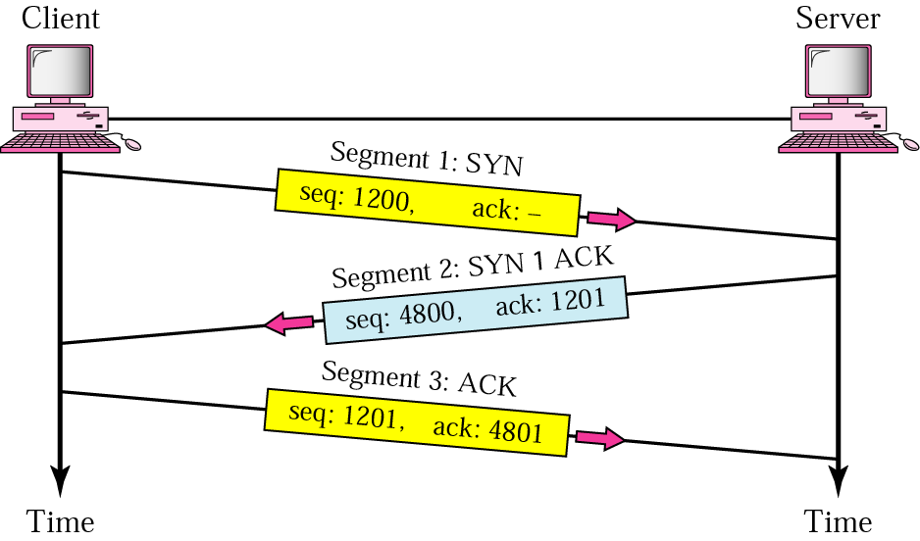
TCP connection establishment
Three-way handshake
Notes:
The algorithm used by TCP to establish and terminate a connection is called a three-way handshake. We first describe the basic algorithm and then show how it is used by TCP. The three-way handshake involves the exchange of three messages between the client and the server, as illustrated in the figure above.
The idea is that two parties want to agree on a set of parameters, which, in the case of opening a TCP connection, are the starting sequence numbers the two sides plan to use for their respective byte streams. In general, the parameters might be any facts that each side wants the other to know about. First, the client (the active participant) sends a segment to the server (the passive participant) stating the initial sequence number it plans to use (Flags = SYN, SequenceNum = x). The server then responds with a single segment that both acknowledges the client’s sequence number (Flags = ACK, Ack = x + 1) and states its own beginning sequence number (Flags = SYN, SequenceNum = y). That is, both the SYN and ACK bits are set in the Flags field of this second message. Finally, the client responds with a third segment that acknowledges the server’s sequence number (Flags = ACK, Ack = y + 1). The reason that each side acknowledges a sequence number that is one larger than the one sent is that the Acknowledgment field actually identifies the “next sequence number expected,” thereby implicitly acknowledging all earlier sequence numbers. Although not shown in this timeline, a timer is scheduled for each of the first two segments, and if the expected response is not received, the segment is retransmitted.

Slide 18
TCP connection establishment
Three-way handshake
Notes:
The algorithm used by TCP to establish and terminate a connection is called a three-way handshake. We first describe the basic algorithm and then show how it is used by TCP. The three-way handshake involves the exchange of three messages between the client and the server, as illustrated in the figure above.
The idea is that two parties want to agree on a set of parameters, which, in the case of opening a TCP connection, are the starting sequence numbers the two sides plan to use for their respective byte streams. In general, the parameters might be any facts that each side wants the other to know about. First, the client (the active participant) sends a segment to the server (the passive participant) stating the initial sequence number it plans to use (Flags = SYN, SequenceNum = x). The server then responds with a single segment that both acknowledges the client’s sequence number (Flags = ACK, Ack = x + 1) and states its own beginning sequence number (Flags = SYN, SequenceNum = y). That is, both the SYN and ACK bits are set in the Flags field of this second message. Finally, the client responds with a third segment that acknowledges the server’s sequence number (Flags = ACK, Ack = y + 1). The reason that each side acknowledges a sequence number that is one larger than the one sent is that the Acknowledgment field actually identifies the “next sequence number expected,” thereby implicitly acknowledging all earlier sequence numbers. Although not shown in this timeline, a timer is scheduled for each of the first two segments, and if the expected response is not received, the segment is retransmitted.

Slide 19
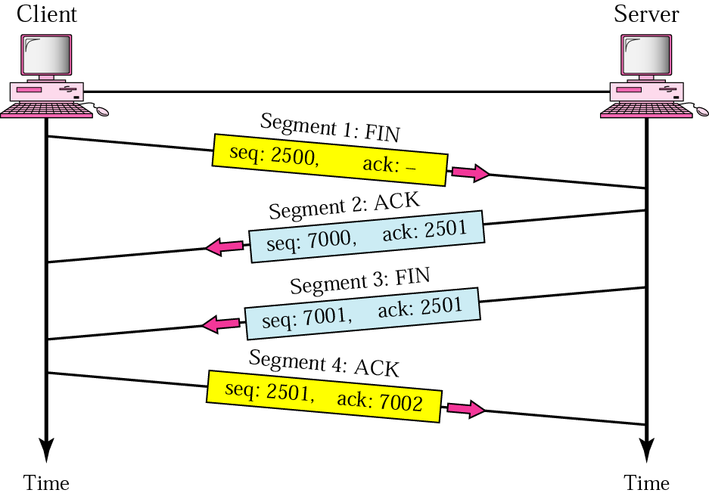
TCP connection termination
Pair of two-way handshakes
Notes:
A TCP connection is normally terminating using a special procedure where each side independently closes its end of the link. It normally begins with one of the application processes signalling to its TCP layer that the session is no longer needed. That device sends a FIN message to tell the other device that it wants to end the connection, which is acknowledged. When the responding device is ready, it too sends a FIN that is acknowledged; after waiting a period of time for the ACK to be received, the session is closed.
Why have a four way exchange rather than a three-way exchange?
The reason is that TCP supports half-closed connections. If A decides it has finished it will send a FIN to B. But B might still have data to send. If it has it will ACK the FIN but won't send a FIN until it has actually finished. Finally, A will send an ACK to B.

Slide 20
TCP connection termination
Closing a TCP connection
Notes:
A TCP connection is normally terminating using a special procedure where each side independently closes its end of the link. It normally begins with one of the application processes signalling to its TCP layer that the session is no longer needed. That device sends a FIN message to tell the other device that it wants to end the connection, which is acknowledged. When the responding device is ready, it too sends a FIN that is acknowledged; after waiting a period of time for the ACK to be received, the session is closed.
Why have a four way exchange rather than a three-way exchange?
The reason is that TCP supports half-closed connections. If A decides it has finished it will send a FIN to B. But B might still have data to send. If it has it will ACK the FIN but won't send a FIN until it has actually finished. Finally, A will send an ACK to B.

Slide 21
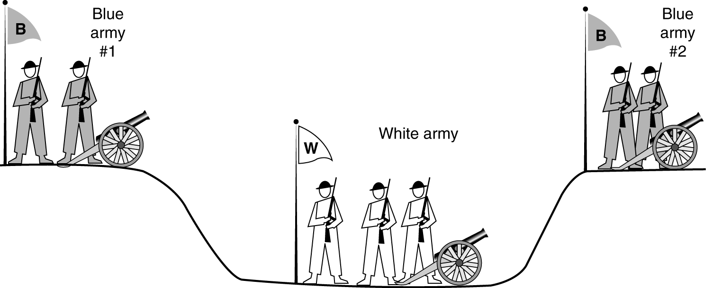
Connection Release
Two-Army Problem
Can we devise a solution to release a connection such that the two parties will always agree with certainty?
The answer is simple: NO

Slide 22
Connection Release
How does one side know that the other side has seen its disconnect message?
To be ABSOLUTELY sure is impossible
Pragmatic solution: Use timeout mechanisms
This will catch most cases, but it is never a fool-proof solution
The initial DR and all retransmissions may still be lost, resulting in a half-open connection

Slide 23
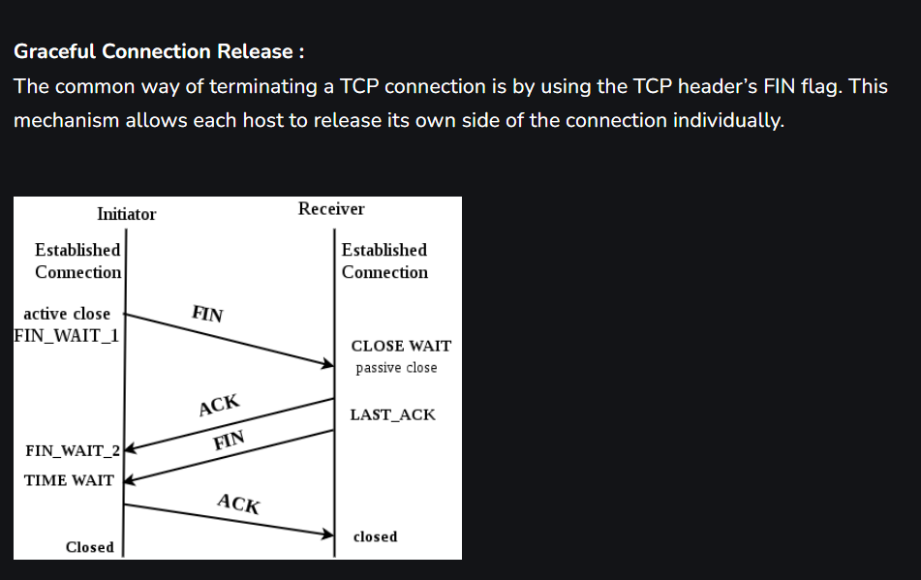

Slide 24
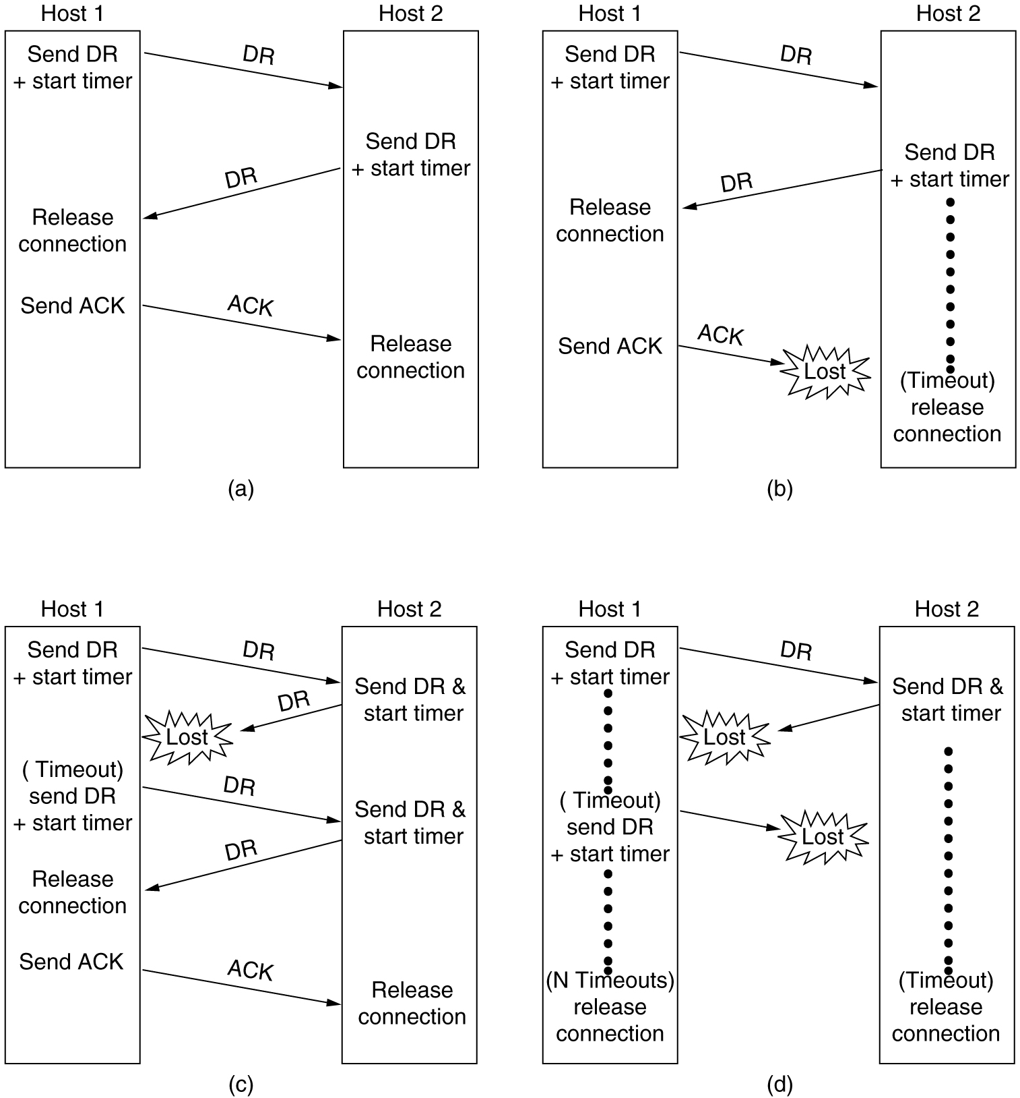
Normal case of a three-way handshake
Final ACK lost
Notes:
DR=Disconnection Request

Slide 25
(c) Response lost (d) Response lost and subsequent DRs lost

Slide 26
Connection Release (Problem)
The two-army problem • For blue army to win, both troops(1&2)must attack white army at same time
• For sync., #1 sends msg. to #2 and waits for ACK. Even though #1 receives ACK, attack is not possible as #2 doesn’t know whether #1 has received its ACK or not
• Even, 3-way handshaking (#1 again sending ACK) will not guarantee successful attack as now #1 is not sure if #2 has received its ACK
• It can be proved that no protocol exists that works, but little risk can be taken while releasing the connection.
• Although 3-way handshaking is not infallible, it is usually adequate.

Slide 27
[ End of lecture ]
Images are copyrights of their respective owners
Some material in this lecture is taken from:
Dr Junaid Qadir, NUST-SEECS

